Slide 1

CLASSIFICATION OF SIGNIFICANT WATER RESOURCES AND DETERMINATION OF RESOURCE QUALITY OBJECTIVES FOR WATER RESOURCES IN THE USUTU TO MHLATHUZE CATCHMENTS (WP11387)
8.8 RESULTS FOR CONSIDERATION: PRELIMINARY CLASSES AND CATCHMENT CONFIGURATIONS

Slide 2
CLASSES AND CATCHMENT CONFIGURATIONS
Patsy Scherman

Slide 3
BACKGROUND
RU = unit of delineation for the Reserve: Nested with IUAs and may contain an EWR site.
IUA = unit of delineation for Classification: An area to be managed as an entity in terms of water resource operations, quality, socio-economics and ecosystem services.
PES: Current integrated state of a water resource.
REC: Future ecological state (Ecological Categories A to D) that can be recommended for a resource.
TEC: This is the resulting Ecological Category based on the Class. One will always strive to meet the REC, however once the balance between use and protection is considered, the TEC may be the PES, the REC or any other category, including a possible improvement of the REC.
Note: The Water Resource CLASS of an IUA is defined by the distribution of the selected Ecological Categories (the catchment configuration) for the biophysical nodes in the IUA.

Slide 4
STEPS TO ASSIGNING CLASSES
Aim: To assign a Water Resource Class I-III per IUA.
Step-wise approach followed to identify Classes and catchment configurations.
Scenario modelling step: A range of scenarios assessed per IUA. Different scenarios depending on rivers or estuaries in IUA (no common naming possible).
Variables were assessed during the Scenario Consequences step:
  Ecological Status & Protection (integrated river and estuary)
  Ecosystem Services
  GDP
  Employment in terms of number of jobs
Consequences evaluated and Classes defined using the Water Resource Class Decision Support System or WRC-DSS.
Team recommendation on Results and Classes: THIS PRESENTATION
Notes:
Caryn to do the scope, will be Tasks of study, deliverables, reference to previous ewr study, use some of following slides, but simplify

Slide 5
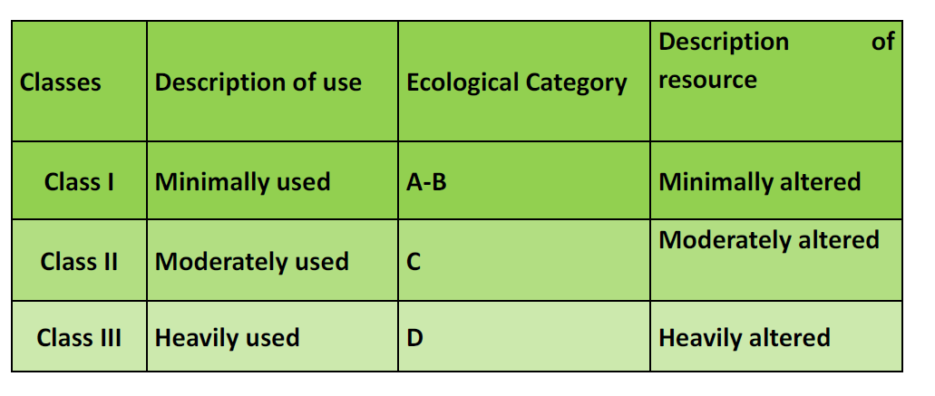

Slide 6
PROCESS PER IUA
Review catchment configuration for RUs in the IUA.
Note driving issues and causes for PES.
Note recommendations re: maintaining current state vs. improving and reasons, e.g. REC with Present Day Flows and non-flow related interventions.
WRC-DSS provides information such as the weight of river RUs vs an Estuary RU (for example) in the IUA – assists in assigning a Class for the IUA.
Per RU in each IUA: assess scenario results (where relevant) for all components (ecological, ES, GDP, jobs).
  Operational scenarios generally have little impact in Usutu-Mhlatuze catchments, particularly for rivers.

Slide 7
PROCESS PER IUA
Useful model outputs that assist in assigning Classes.
Assign a Class.
Test with PMC and PSC.

Slide 8
PRESENTATION OF RESULTS
  Table of proposed Classes per IUA.
  Using maps and the following colour coding, provide an example of the Water Resource Classes and a selection of IUAs with nodes requiring intervention.
  For selected IUAs provide a summary of the interventions required to achieve the Class and Ecological Categories for the catchment configuration.
WRC I
WRC II
WRC III

Slide 9
W12-a: Upper Mhlatuze
W12-1: B
W12-2: B
W12-3: C
W12-4: B/C
W12-d
W12-9: C
Nhlabane Estuary: E
W12-b
W12-5: B
W12-7: B
W12-8, NS1: C
W1
W12-e
W12-10: C
Lake Msingazi: D
W11: Matigulu
W11-1: B
W11-2, MA1: B/C
W11-3: C/D
Matigulu Estuary: B (REC) – Class I
W12-c: Lower Mhlatuze
W12-6: C
Mhlatuze Estuary: D
W13: Mlalazi
W13-1: C
W13-2: B/C
Mlalazi Estuary: B (Rest./Int. scenario)
Siyaya Estuary: B/C (Rest./Int. scenario)

Slide 10
W2
W22: Black Mfolozi
W22-1, BM1: C
W22-2: B/C
W22-3: C
W22-4: C
W21: White Mfolozi
W21-1: B/C
W21-2: B
W21-3: C
W21-4: D
W21-5, WM1: B/C
W21-6: B/C
W21-7, d/s WM1: B/C
W23: Mfolozi
W21-8: B
W22-5: B
W23-1: B
W23-2: B
IUA St Lucia
PES: D or E
REC: B (Class I)

Slide 11
W3
W31-b: Lower Mkuze
W31-4, MK1: B (improve with non-flow intervention)
W31-5: C
W31-6: B
W32-1: B/C
IUA St Lucia
PES: D or E
REC: B (Class I)
W31-a: Upper Mkuze
W31-1: C
W31-2: B
W31-3: B/C
W32-a: Upper Hluhluwe
W32-2: B
W32-b
W32-3: B
W32-4: C
W32-5: C
W32-6: B

Slide 12
W45: Lower Pongola
W43-1: C
W45-1: C
W45, Pongola floodplain: D to C (REC)
W42-a: Upper Pongola
W42-1: B (REC, PD flows)
W42-2, UP1: C
W44: Middle Pongola
W44-1: D (REC, PD flows)
W42-b: Middle Pongola
W41-3: B/C (REC, PD flows)
W42-3: B
W42-4: B
W42-5: B
W41: Bivane
W41-1: B (REC, PD flows)
W42-2: B
W4

Slide 13
W55
W55-1: B/C (REC, PD flows)
W55-2: C (REC, PD flows)
W55-pans, Chrissiesmeer: B
W51-b
W53-1: D (REC, PD flows)
W53-2: B/C (REC, PD flows)
W54-1: B (REC, PD flows)
W57
W57-1: B (REC, PD flows)
W57-Ndumo pans: A
W52
W51-2: C (REC, PD flows)
W51-3, AS1: C
W51-4: C (REC, PD flows)
W52-1: B/C (REC, PD flows)
W53-3, NG1: B/C
W54-2: C (REC, PD flows)
W51-a
W51-1: C
W5

Slide 14
W7
W70-Muzi swamps: C
W70-a
W70-1: D
W70-2: B
W70-Kosi lakes & Estuary: A/B
W70-b
W70-3: D
W70-Lake Sibaya: A
W70-uMgobezeleni Estuary: A

